Slide 1
PA 103: Introduction to Microeconomics

Slide 2
Lecture 4 Specialization and Trade

Slide 3
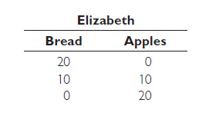
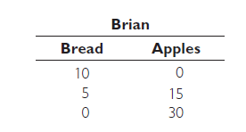
Specialization and Trade
Trade Can Move Us Beyond Our PPF
Here, we explain how a country that specializes in the production of certain goods, and then trades those goods to countries for other goods, can make itself better off.
A Simple Two-Person PPF Model
Two individuals, Elizabeth and Brian, live near each other, and each engages in two activities: baking bread and growing apples.

Slide 4
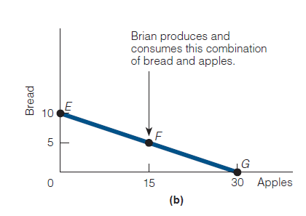
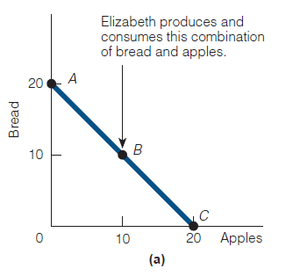
Specialization and Trade
Trade Can Move Us Beyond Our PPF
The production possibilities frontier of Elizabeth and Brian are as follow,

Slide 5
Specialization and Trade
Trade Can Move Us Beyond Our PPF
As a consumer, Elizabeth likes to eat both bread and apples; so she decides to produce (and consume) at point B in panel (a).
Brian, like Elizabeth, likes to eat both bread and apples; so he decides to produce and consume at point F in panel (b).
Elizabeth thinks that both she and Brian may be better off if each specializes in producing only one of the two goods and trading it for the other. Brian also thinks so.
But they are not sure which good each person should specialize in producing.

Slide 6
Specialization and Trade
Trade Can Move Us Beyond Our PPF
The production possibilities frontier of Elizabeth and Brian are as follow,

Slide 7
Specialization and Trade
Trade Can Move Us Beyond Our PPF
An economist would advise each to produce the good that he or she can produce at a lower cost.
In economics, a person who can produce a good at a lower cost than another person is said to have a comparative advantage in the production of the good.
Panel (a) shows that for every 10 units of bread Elizabeth does not produce, she can produce 10 apples.
In other words, the opportunity cost of producing 1 loaf of bread (B) is 1 apple (A):

Slide 8


Specialization and Trade
Trade Can Move Us Beyond Our PPF
For every 5 loaves of bread that Brian does not produce, he can produce 15 apples. So, for every 1 loaf of bread he does not produce, he can produce 3 apples. Therefore, for every 1 apple he chooses to produce, he forfeits 1/3 loaf of bread.

Slide 9
Specialization and Trade
Trade Can Move Us Beyond Our PPF
Comparing opportunity costs, we see that Elizabeth can produce bread at a lower opportunity cost than Brian can. On the other hand, Brian can produce apples at a lower opportunity cost than Elizabeth can.
We conclude that Elizabeth has a comparative advantage in the production of bread, and Brian has a comparative advantage in the production of apples.
Suppose both specialize in the production of the good in which they have a comparative advantage. Elizabeth produces only bread and makes 20 loaves. Brian produces only apples and grows 30 of them.

Slide 10
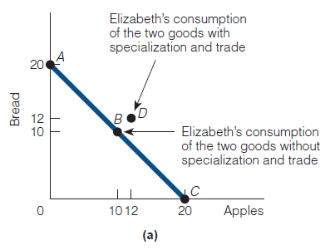
Specialization and Trade
Trade Can Move Us Beyond Our PPF
Now suppose that Elizabeth and Brian decide to trade 8 loaves of bread for 12 apples. That is after the trade, Elizabeth consumes 12 loaves of bread and 12 apples.
Compare this situation with no trade situation, clearly, Elizabeth is better off when she specializes and trades than when she does not.

Slide 11
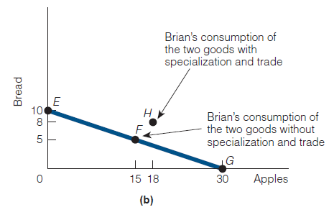
Specialization and Trade
Trade Can Move Us Beyond Our PPF
On the other hand, Brain produces 30 apples and trades 12 of them to Elizabeth for 8 loaves of bread. In other words, he consumes 8 loaves of bread and 18 apples.
Compare this situation with no trade situation, clearly he is also better off when he specializes and trades than when he does not.

Slide 12
Specialization and Trade
On or Beyond the PPF?
In Elizabeth’s PPF, when she was not specializing and not trading, she consumed the combination of bread and apples represented by point B (10 loaves of bread and 10 apples).
When she did specialize and trade, her consumption of both goods increased, moving her to point D (12 loaves of bread and 12 apples).
Lesson learned: Through specialization and trade, Elizabeth’s consumption moved beyond her PPF. It is easy to see the benefits of specialization of trade.
In Brian’s PPF, when he was not specializing and not trading, he consumed the combination of bread and apples represented by point F (5 loaves of bread and 15 apples).

Slide 13
Specialization and Trade
On or Beyond the PPF?
When he did specialize and trade, his consumption of both goods increased, moving him to point H (8 loaves of bread and 18 apples).
Lesson learned: Through specialization and trade, Brian’s consumption moved beyond his PPF.
What holds for Elizabeth and Brian through specialization and trade holds for countries too.
For example, if both Americans and Brazilians specialize in producing those goods for which they have a comparative advantage and then trade some of those goods for the others’ goods, both Americans and Brazilians can consume more of both goods than if they don’t specialize and don’t trade.

Slide 14
The Circular-Flow Diagram
The Circular-Flow Diagram
To understand how the economy works, we need a model that explains, how the economy is organized and how participants in the economy interact with one another.
The circular-flow diagram is a visual model of the economy that shows how dollars flow through markets among households and firms.

Slide 15
The Circular-Flow Diagram
The Circular-Flow Diagram
The economy is simplified to include only two types of decision makers
Firms
Produce and sell goods and services
Hire and use factors of production
Households
Buy and consume goods and services
Own and sell factors of production

Slide 16
The Circular-Flow Diagram
The Circular-Flow Diagram
Households and firms interact in two types of markets.
Markets for Goods and Services
Firms sell
Households buy
Markets for Factors of Production
Households sell
Firms buy
Factors of Production
Inputs used to produce goods and services
Land, labor, capital, entrepreneurship.

Slide 17
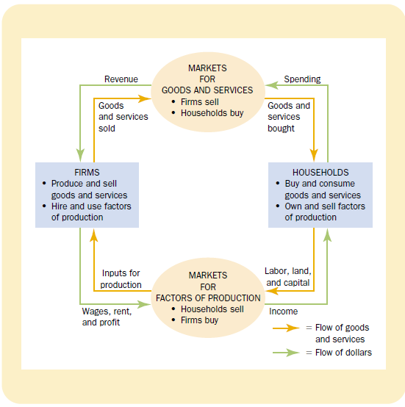
The Circular-Flow Diagram
The Circular-Flow Diagram

Slide 18
The Circular-Flow Diagram
The Circular-Flow Diagram
The circular flow diagram offers a simple way of organizing all the economic transactions that occur between households and firms in the economy.
The inner loop of the diagram shows the flows of inputs and outputs.
The households sell factors to the firms in the markets for factor of production.
The firms then use these factors to produce goods and services which in turn are sold to households in the market for goods and services.

Slide 19
The Circular-Flow Diagram
The Circular-Flow Diagram
The outer loop of the diagram shows the corresponding flow of dollars.
The households spend money to buy goods and services from the firms.
The firms use some of the revenue to pay for the factors of production which in turn owned by the households.
Hence spending on goods and services flows from households to firms and in the form of wages, rent and profit flows from firms to households.

Slide 20
Readings
Roger A. Arnold- Microeconomics, 10th Edition, Chapter – 2.
Notes on Lecture 4

Slide 21


Slide 22
Thank You

